Slide 1
GAS SENSING GRENADE
Team No: 16
Team Name: BIT PLEASE
Members:
Midhun C Kachappilly
Akhil M
Aswin S

Slide 2
Problem
The firefighters and rescue officials face serious risks on their job. They face heat, flames, physical and mental stress, and high levels of carbon monoxide (CO) and other toxic gases in the areas around fires, that may be caused by natural calamities or accidents. They may not know what kind of contamination is present and they may not be able to take the necessary precautions before taking action. An increase in firefighter’s risk, will hinder the progress in a fire situation.

Slide 3
Solution
In an exigency like this, to ease things up a bit, we need to gather information about the various constituents of gases present and their respective concentrations. If we are able to do this quickly, precautions can be taken and lives can be saved.

Slide 4
How we solved it
The Gas Sensing Grenade (GSG) is a prototype that implements this idea and shows its working mechanism.
The GSG consists of a gas sensor called MQ2. It is capable of detecting three types of gases, LPG, CO and Smoke. The changing resistance due to the presence of various gases is how the sensor measures the values.
The MQ2 is connected to an Arduino UNO board which collects the values and transmits it in audio format with the help a Radio Frequency transmitter.
The value is received by an RF receiver which is coupled with an amplifier.
The amplified signal can be heard using an earphone or walkie-talkie.

Slide 5
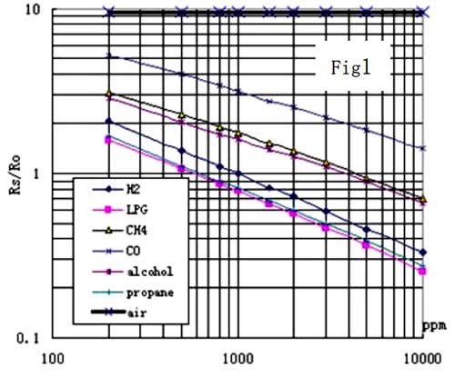

Slide 6
The transmission can also be done using NODE MCU (thereby using Wi-Fi instead of RF), received by a mobile phone using internet. Here the usage of Arduino can be completely avoided for the purpose of transmission.
The grenade has one wheel powered by DC geared motor and two ball caster wheels. After collecting a set of values, the grenade moves a little bit ahead using the powered wheel and one of the two ball caster wheels. This is done so as to cover the whole room.
GSG also has a buzzer which will be activated when any of the above gases are present. This will act as warning system if the rescuer decides to act drastically.
The design of the grenade is such that its centre of gravity is dominated towards one side. So, when the grenade is thrown, regardless of how it falls, it will eventually position itself in such a way that the powered wheel and one of the two caster wheels will enable its locomotion.

Slide 7
Materials used
MQ2 Gas Sensor - 1
Arduino UNO - 1
L293D Motor Driver - 1
DC Geared Motor - 1
Wheel - 1
Ball Caster Wheels - 2
Frustum Shaped Chassis - 1
RF Transceiver Module - 1
BC547 Amplifier Circuit - 1
Earphone/Audio output device - 1
LED - 1
Buzzer - 1
Connecting wires

Slide 8
Materials for alternative method of transmission
Instead RF transmission, we can use:-
NODE MCU - 1
Mobile phone with Internet - 1
This will completely avoid the usage of Arduino for the purpose of transmission.

Slide 9
How the project is related to the theme
The theme, “Robotics for Humanity”, aims at engaging the delegates in designing and showcasing their ideas that might end up having an impact in the society, by either improving the lives of the people or saving it altogether. Our project, Gas Sensing Grenade, is a prototype that will definitely help save lives in emergency contamination related situations.
Rescue operations require desperate measures and in desperate attempts, many precautions may be unintentionally neglected. GSG allows a quick check, a last moment forethought, that could potentially save lives. By saving firefighters’ lives, you increase the chances of survival of the people being rescued.

Slide 10
Average cost of production
Materials | Cost (₹)
MQ2 Gas Sensor | 140.00
Arduino UNO | 450.00
L293D Motor Driver | 160.00
DC Geared Motor | 200.00
Wheel | 70.00
Ball Caster Wheels | 25.00 × 2 = 50.00
Frustum Shaped Chassis | 30.00
RF Transceiver Module | 150.00
BC547 Amplifier Circuit | 50.00
Earphone/Audio output device | 100.00
LED | 2.00
Buzzer | 20.00
Other Expenses (Wires, hot glue, etc) | 50.00
TOTAL | 1472.00

Slide 11
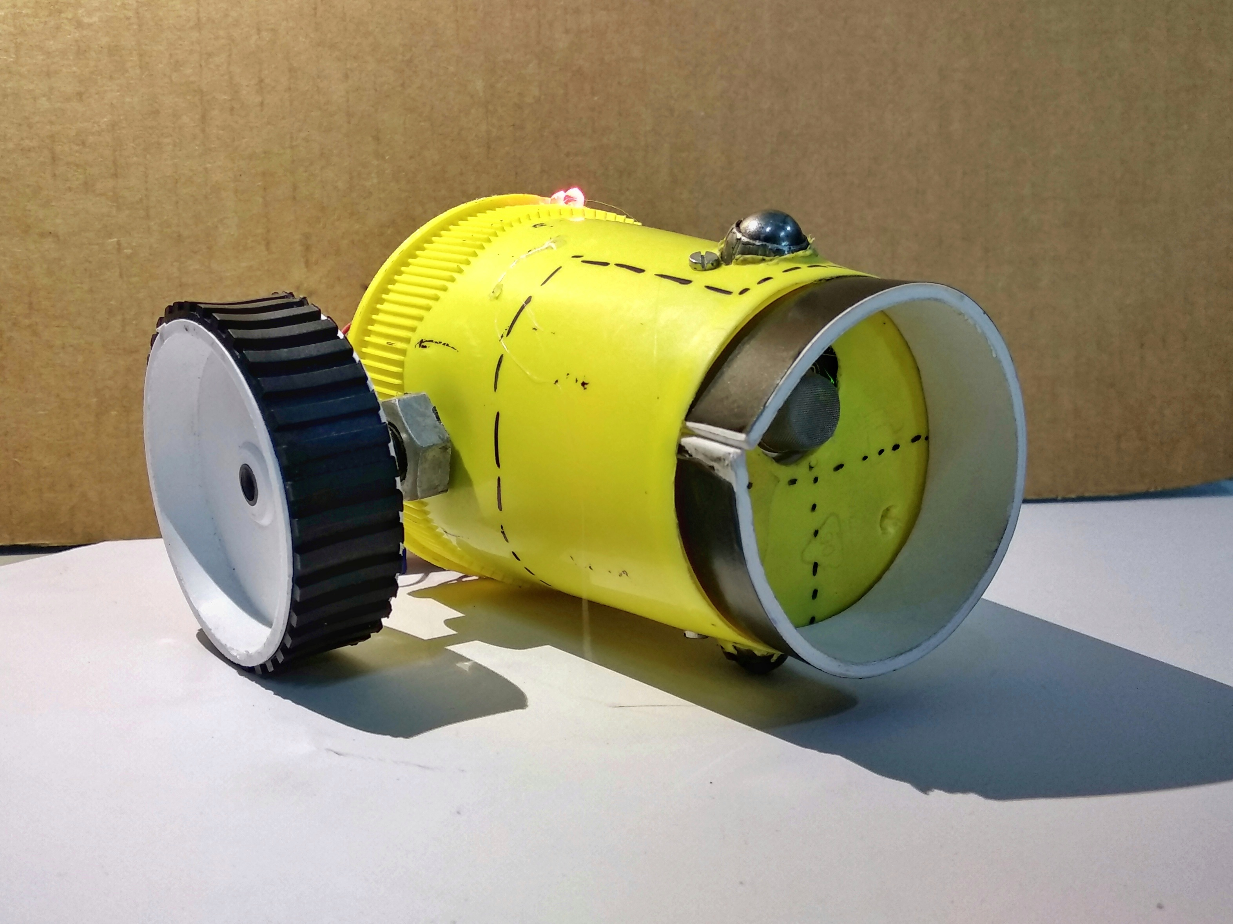
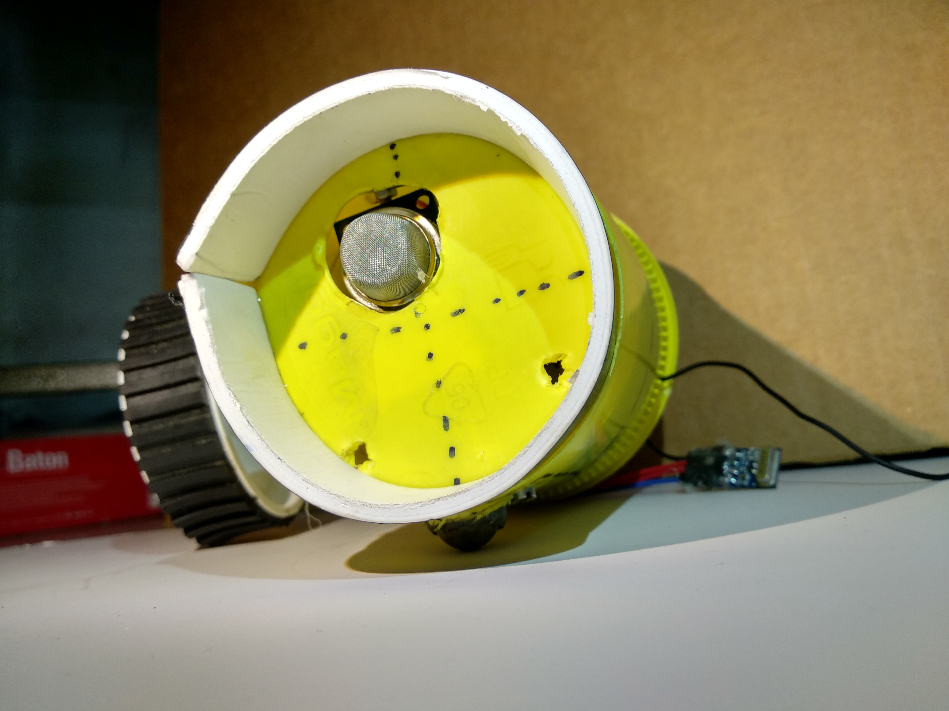
Pictures

